Slide 1


Slide 2


SQL INJECTION

Slide 3
TABLE OF CONTENTS
01
02
03
04
SQL
SQL Query
SQL Commands
SQLI
05
06
07
08
Working
Types of SQLI
Impact
Tools used

Slide 4
SQL
SQL (often pronounced like “sequel”) stands for Structured Query Language
SQL is a standard language for storing, manipulating and retrieving data in databases.
It became a standard of the American National Standards Institute (ANSI) in 1986, and of the International Organization for Standardization (ISO) in 1987 .

Slide 5
SQL Query
A SQL query is a request for data or information from a database table or combination of tables. This data may be generated as results returned by Structured Query Language (SQL) or as pictorials, graphs or complex results.

Slide 6
SOME OF THE MOST IMPORTANT SQL COMMANDS
SELECT
UPDATE
DELETE
INSERT
CREATE
ALTER
CREATE TABLE
ALTER TABLE
DROP TABLE
CREATE INDEX
DROP INDEX
-
-
-
-
-
-
-
-
-
-
-
-
Extracts data from the database
Updates data in the database
Deletes data from the database
Inserts new data into the database
Creates a new database
Modifies a database
Creates a new table
Modifies a table
Deletes a table
Creates an index (Search key)
Deletes an index

Slide 7
Example
Here is the basic syntax
SELECT
Item Name, Item Description
FROM [Table]
WHERE = Item Number

Slide 8
SQL
Injection
SQL injection (SQLi) is a web security vulnerability that allows an attacker to interfere with the queries that an application makes to its database.

Slide 9
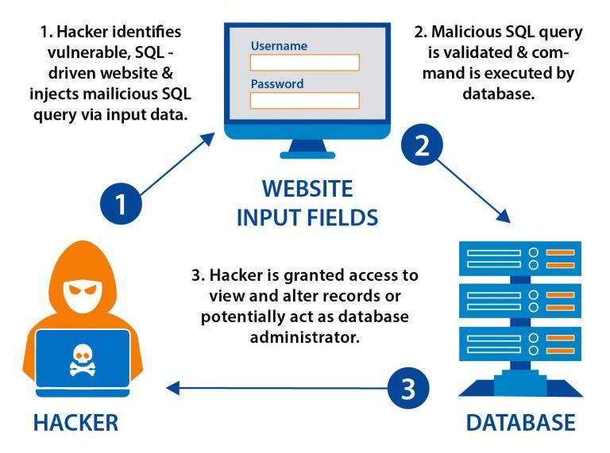
WORKING

Slide 10
Types
Error-based sqli
Union-based sqli
01
Blind-Boolean based sqli
Blind-Time based sqli
1. Inband sqli
2. Inferential sqli
3. Out-of-Band sqli
02
Provides an alternative to Inferential Time-based techniques
03
Auth-Bypass Technique
04

Slide 11
IN-BAND SQL INJECTION
In-band SQL injection is the most common and easy-to-exploit of the SQL injection attacks.
In-band SQL injection occurs when an attacker is able to use the same communication channel to both launch the attack and gather results.

Slide 12
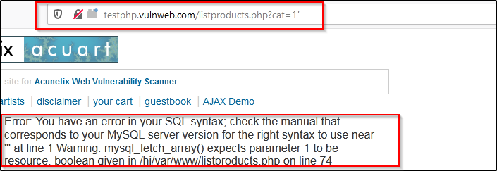
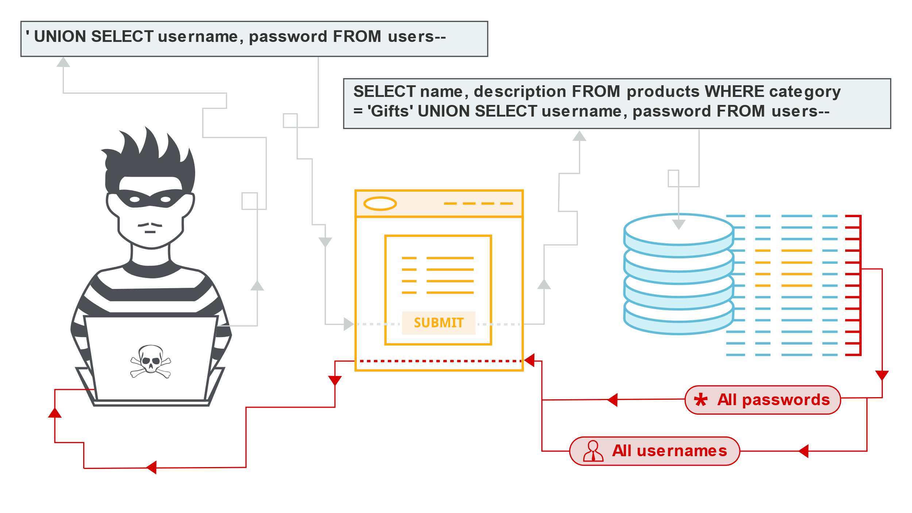
In-band SQL Injection
ERROR-BASED SQL INJECTION
UNION-BASED SQL INJECTION
This technique relies on error messages thrown by the database server to obtain information about the structure of the database.
02
This technique leverages the UNION SQL Operator to combine the results of two or more SELECT statements into a single result which is then returned as part of the HTTP response.
01
ERROR-BASED
UNION-BASED

Slide 13
INFERENTIAL SQL INJECTION
This technique, unlike In-band SQLi, may take longer to exploit.
Such attacks are commonly referred to as “Blind SQLi attacks”
Here, an attacker will be able to reconstruct the database structure by sending payloads, observing the web application’s response and the resulting behavior of the database server.

Slide 14
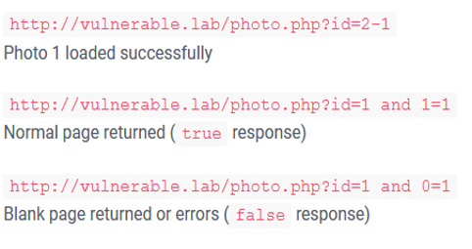
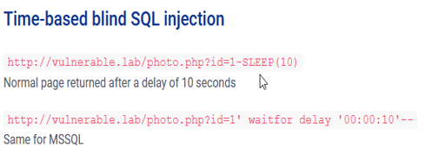
Inferential SQL Injection
BOOLEAN-BASED SQL INJECTION
TIME-BASED SQL INJECTION
This technique relies on sending an SQL query to the database which forces the application to return a different result depending on whether the query returns a TRUE or FALSE result.
This technique that relies on sending an SQL query to the database which forces the database to wait for a specified amount of time (in seconds) before responding.
The response time will indicate to the attacker whether the result of the query is TRUE or FALSE.
01
02
BOOLEAN-BASED
TIME-BASED

Slide 15
OUT-OF-BAND SQL INJECTION
Out-of-band SQL injection is when an attacker is unable to use the same channel to launch the attack and gather results.

Slide 16
SQL AUTH-BYPASS

Slide 17
IMPACT
SQL injection can leave the application at a high-risk of compromise resulting in an impact to the confidentiality, and integrity of data as well as authentication and authorization aspects of the application. It poses highly critical issues as these can be used to extract complete database contents and, in some cases, can be leveraged to a Command execution on the server.

Slide 18
TOOLS
sqlmap
sqlninja
Acunetix
Nessus

Slide 19
References
https://www.w3schools.com/sql/default.asp
https://portswigger.net/web-security/sql-injection
https://www.researchgate.net/publication/309404360_CASE_STUDY_OF_SQL_INJECTION_ATTACKS
https://resources.infosecinstitute.com/topic/sql-injection-vulnerabilities-exploitation-case-study/
https://www.techopedia.com/definition/5736/query
https://www.mssqltips.com/sqlservertip/7163/sql-query-examples/

Slide 20
Thank you

